Slide 1


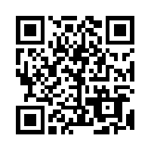
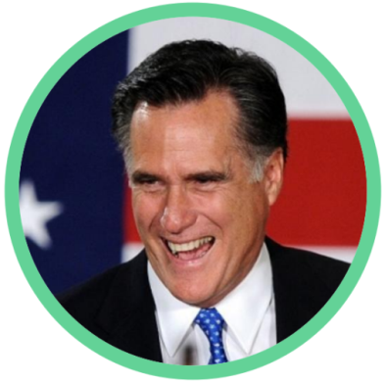
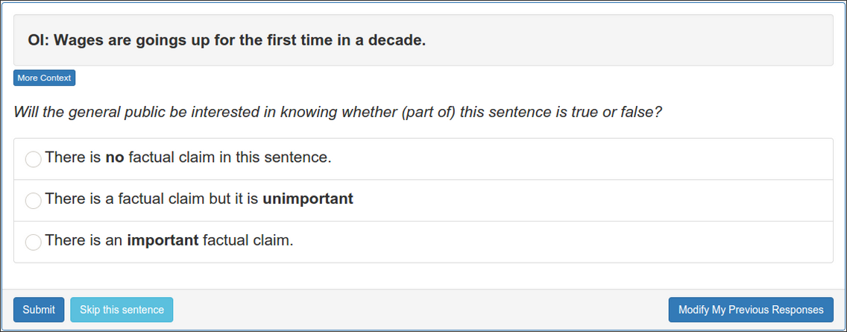
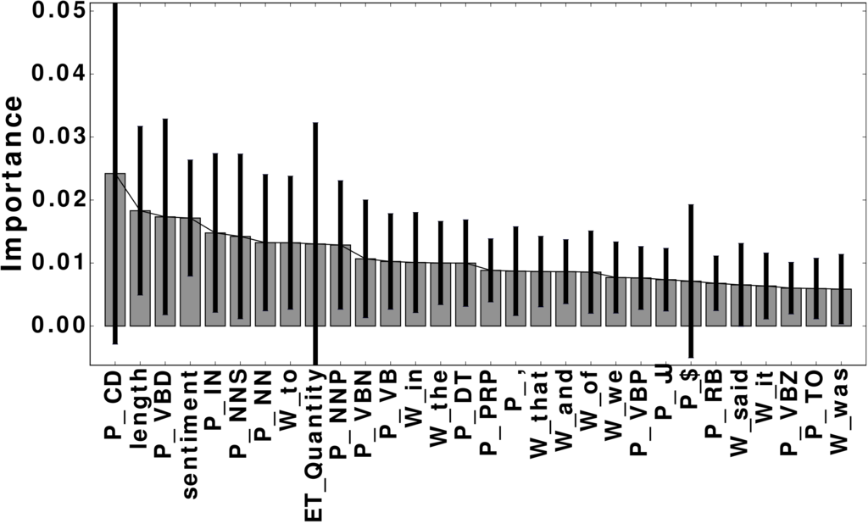
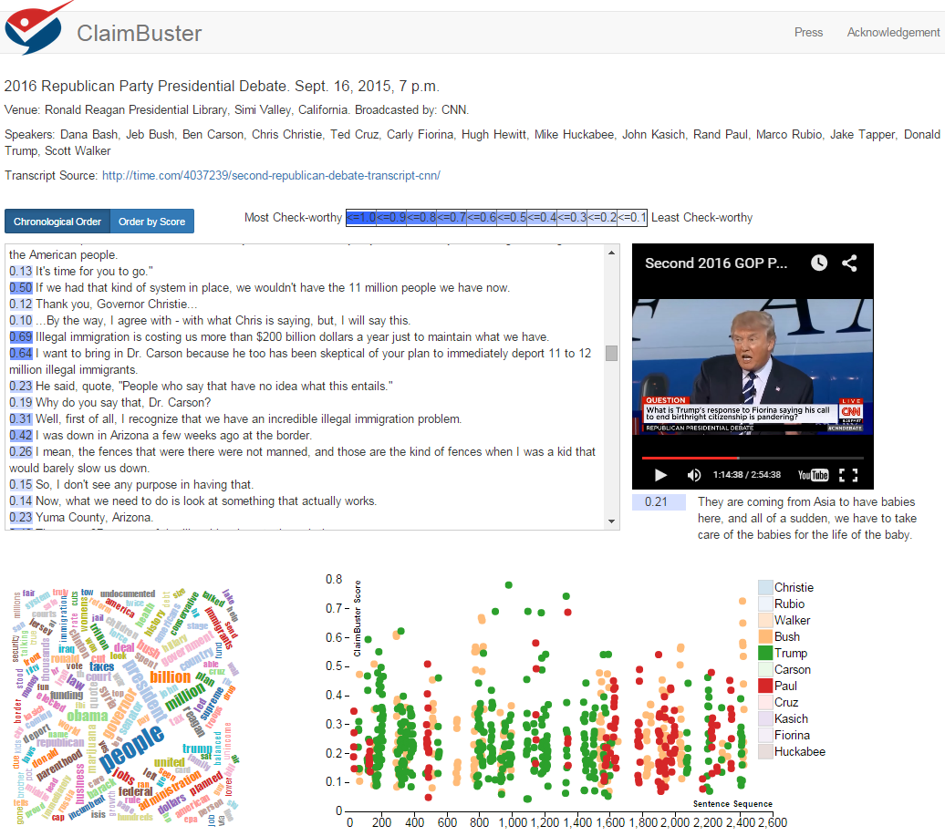
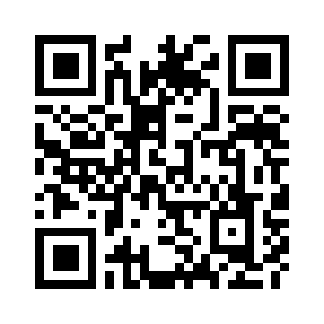







Detecting Check-worthy Factual Claims in
Presidential Debates
Naeemul Hassan, Chengkai Li, Mark Tremayne
Motivation
Ground Truth Collection
People make claims all the time
Developed a data collection platform bit.ly/claimbusters
Accumulated 226 participants in 3 months.
600 screening sentences were used to detect spammer and low-quality participants.
Sentences agreed by 2 top-quality participants were used as ground truth.
“I built a net worth of more than $10 billion’’
-Donald Trump in 2016 GOP presidential candidate debate.
factcheck.org checked this claim as False.¹
“... our Navy is smaller than it’s been since 1917.’’
-Mitt Romney in 2012 Presidential candidate debate. Politifact.org checked this claim as Pants on Fire.²
Class | Count
CFS | 1673
UFS | 482
NFS | 5860
Fact-checking is growing, but human challenges remain
64 active fact-checking sites worldwide³, up from 44 in 2014.
Falsehoods growing faster than fact-checkers.
Limitations of current approach
Feature Extraction & Selection
Find
Claims
Determine
Accuracy
Write
Report
Publish
Sentiment: 0.032
Words:
state, legislature, 87, percent, democrat
Journalists
spend hours going through documents to identify claims.
-Significant time gap between speech and reporting times.
-Audience does not get correct information.
-Requires advanced
writing skills
to persuade readers.
-Such skilled writers
are sparse.
Lack of Structured
Journalism and use of old publishing
frameworks hinders
Semantic Web
applications.
I was in a state where my legislature was 87 percent Democrat.
Part-of-Speech:
Noun
Entity Type:
Quantity
Concept:
United States
Word | percent; people
POS tag | noun; cardinal number;
Entity Type | Quantity; Country;
Concept | United States Senate; Barack Obama
Dataset
U.S. Presidential Debate Transcripts [1960 - 2012]
11 Presidential Elections. 30 Debates
20788 Sentences [excluding short sentences (less than 5 words)]
Evaluation
 | Precision | Recall | F-measure
NFS | 0.90 | 0.96 | 0.93
UFS | 0.65 | 0.26 | 0.37
CFS | 0.79 | 0.74 | 0.77
K | P@K | NDCG@K
25 | 1 | 1
50 | 1 | 1
100 | 0.960 | 0.970
200 | 0.940 | 0.951
300 | 0.853 | 0.881
4 fold cross validation.
Algorithms: Naïve Bayes, Random Forest, Support Vector Machine.
Support Vector Machine generally outperformed others.
Prototype: idir.uta.edu/ClaimBuster
Problem Formulation
Three categories of sentences
Non-Factual Sentence (NFS): (Opinions, beliefs, declarations)
But I think it’s time to talk about the future.
You remember the last time you said that?
Unimportant Factual Sentence (UFS):
Next Tuesday is Election Day.
Two days ago we ate lunch at a restaurant
Check-worthy Factual Sentence (CFS):
He voted against the first Gulf War.
Over a million and a quarter Americans are HIV-positive.
Goal: Given a sentence, find if it belongs to CFS category. A supervised learning problem.
Human Annotation
Ground Truth
Feature Extraction
Feature Vectors
Learning Algorithm
Presidential Debate Transcripts
ClaimBuster
www.factcheck.org/2015/08/factchecking-the-gop-debate-late-edition/
www.politifact.com/truth-o-meter/statements/2012/jan/18/mitt-romney/mitt-romney-says-us-navy-smallest-1917-air-force-s/
http://reporterslab.org/snapshot-of-fact-checking-around-the-world-july-2015/

